Slide 1
SAP BTP Extension Suite Training
Day 16
Anubhav Oberoy
www.AnubhavTrainings.com
Follow excellence with sheer passion

Slide 2


DISCLAIMER
The training content and delivery of this presentation is confidential, and cannot be recorded, or copied and distributed to any third party, without the written consent of Anubhav Trainings

Slide 3
Agenda – Day 16
01
CAP Extension
02
Free style App
03
Deploy App

Slide 4
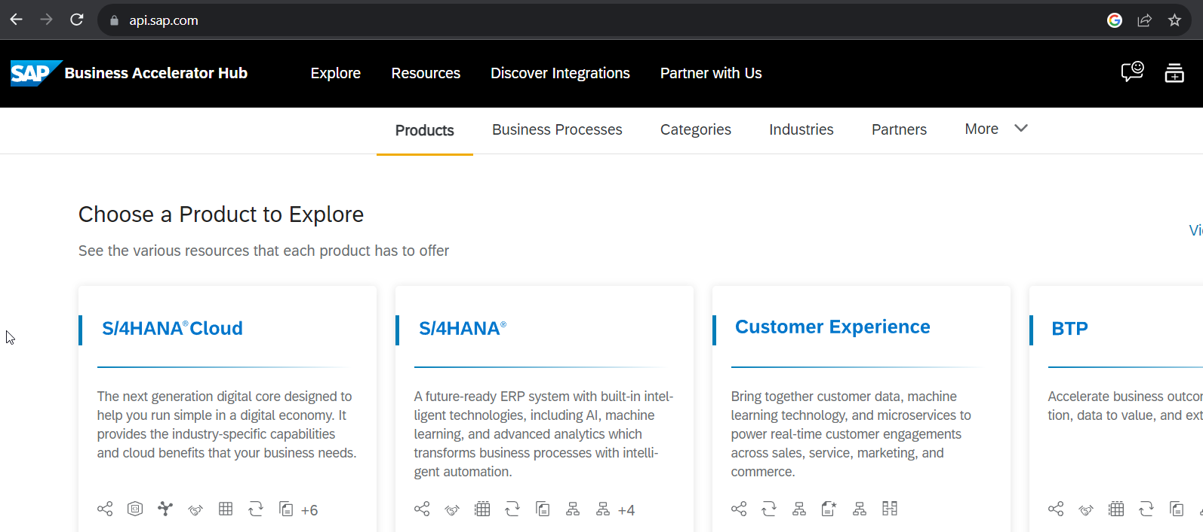
SAP Business API HUB
The SAP API Business Hub is a web application hosted by SAP to discover, explore, and test SAP and partner APIs (application programming interfaces). API’s enable to build extensions or process integrations.
Access
The SAP API Business Hub is a public website https://api.sap.com that anyone can access. You might however need to login to experience some of our features.
What are APIs?
An API is a programming object that enables developers to use or extend the provided functionality in a service. With API’s you can extend solutions, integrate them with other solutions, or build new apps.
Different API types
You will find REST, SOAP, and OData APIs on the SAP API Business Hub. A description for the different API types you can find here.

Slide 5

Hands-on : Find SAP Sales Order API in APIHUB & Test in POSTMAN

Slide 6
Scenario 2:
Own Fiori App
SAP or Non SAP API OData which we want to reuse
Android App
SAP UI5 App
CAPM App
Middleware
Data manipulation, enrichment, Security, automation, movement, proxy
SCC
HANA

Slide 7
Hands on: Initialize CAPM Extension
Create a new cap project with cds init
Install the node module @sap-cloud-sdk/generator and @sap-cloud-sdk/odata-v2 as dev dependencies
Drag drop edmx file downloaded from API hub and perform TRANSPILE is VERY IMPORANT
npx generate-odata-client --transpile --input resources/service-specs --outputDir src/generated
Copy src folder inside srv so packaging can be done
Create a new folder service-spec, and cds watch, after that drag drop the edmx file of our service to the folder. It will create external folder
Add a new CatalogService.cds and CatalogService.js
S4HANA cloud sdk is SAP’s portfolio of all the type safe API (node modules) to communicate to SAP APIs.
Code - https://github.com/soyuztechnologies/BTP_Architect_CLD200/tree/master/Day%2015/s4hanaextensions
Add the configuration to test our api locally – credentials
cf create-service xsuaa application myxsuaa
cf create-service-key myxsuaa myxsuaa-key
cds bind --to myxsuaa:myxsuaa-key cds run --profile hybrid
Repeat the same steps for the destination service

Slide 8
@sap-cloud-sdk/generator
To generate code to call business API automatically from CAP to S/4HANA
JS code to call the API
Edmx file

Slide 9










































Slide 11

What We Did
Let’s Summarize

Slide 12

www.anubhavtrainings.com
Thank You
End of Day 15

Slide 13


We’re committed to empower you to be
#FutureReady
through powerful training solutions.
We build the workforce of the future.
260+
Corporate Clients
60,000+
Learners Trained
26000+
Learners Placed
FREE WEBINARS
Sign up for free webinars with industry experts every fortnight!
Enroll Now!
Contact us today!
https://anubhavtrainings.com

